Slide 1
Session 5.1: Practical Response
Disinformation/Malign Influence Training
SJ Terp & P Breuer, Threet Consulting | 2021

Slide 2
Practical response
Practical: response
Setting up a process
Choosing tools
Collecting data (social, text, image)
Building investigation communities
Overlapping communities: cognitive security, OSINT, information security.
How to send data to responders

Slide 3
Setting up a response

Slide 4
Activities
Enablement activities
People
Team organisation
Collaboration management
Evidence
Data engineering
Data governance
Tool selection and setup
Reporting
Info sharing standards
Info sharing mechanisms
Response activities
Monitoring and detection
Triage / initial analysis
Assessment / deeper analysis
Share
Suggest
Act
Evaluate

Slide 5
Organising people and connections

Slide 6
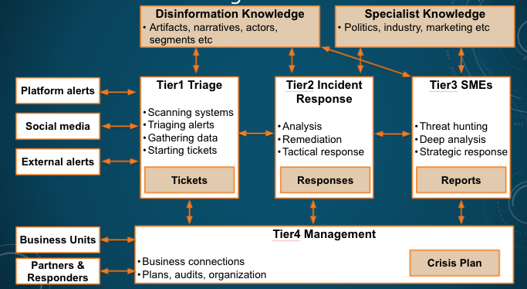
CogSec version of Tiered Security Operations Centers
Notes:
We haven't yet looked at the internal structure of a SOC. This is an example of a tiered model that shows a couple services and their interfaces. There are many ways to do this depending on your size and mandate, and no strict requirement that services and functions are exclusively designated to cog sec. Often we’ll see tiers within a single service area.

Slide 7
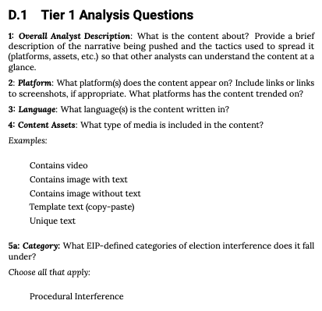
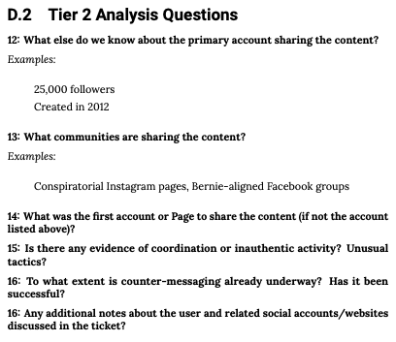
Election Integrity Project tiers
https://www.atlanticcouncil.org/in-depth-research-reports/the-long-fuse-eip-report-read/

Slide 8
Organising evidence collection

Slide 9
Monitoring and Detection
Finding information sources:
Create ways for people/ groups to alert you
Tiplines
Go where the people are
Make it easy but
Have a format
List and contact response groups
Active fact checkers etc
Groups that could monitor/alert/triage
Online sites, groups, influencers
Include subcommunities/ languages
List online data sources
Where will you put data
Go where the people are
APIs and RSS feeds are your friends
Everything else usually has some code
List limits on data sources
Are there any use restrictions
Is this all data, or a subset?
Information source monitoring
Decide on your focus
Set up keyword lists
Look for terms in existing material
Check for co-occurrances
Set up search queries
Create Google dorks
Use Google search
Use google alerts
Create narrative lists / spreadsheets
List known misinformation sites, groups, influencers (e.g. fake experts)

Slide 10
Organising tools

Slide 11
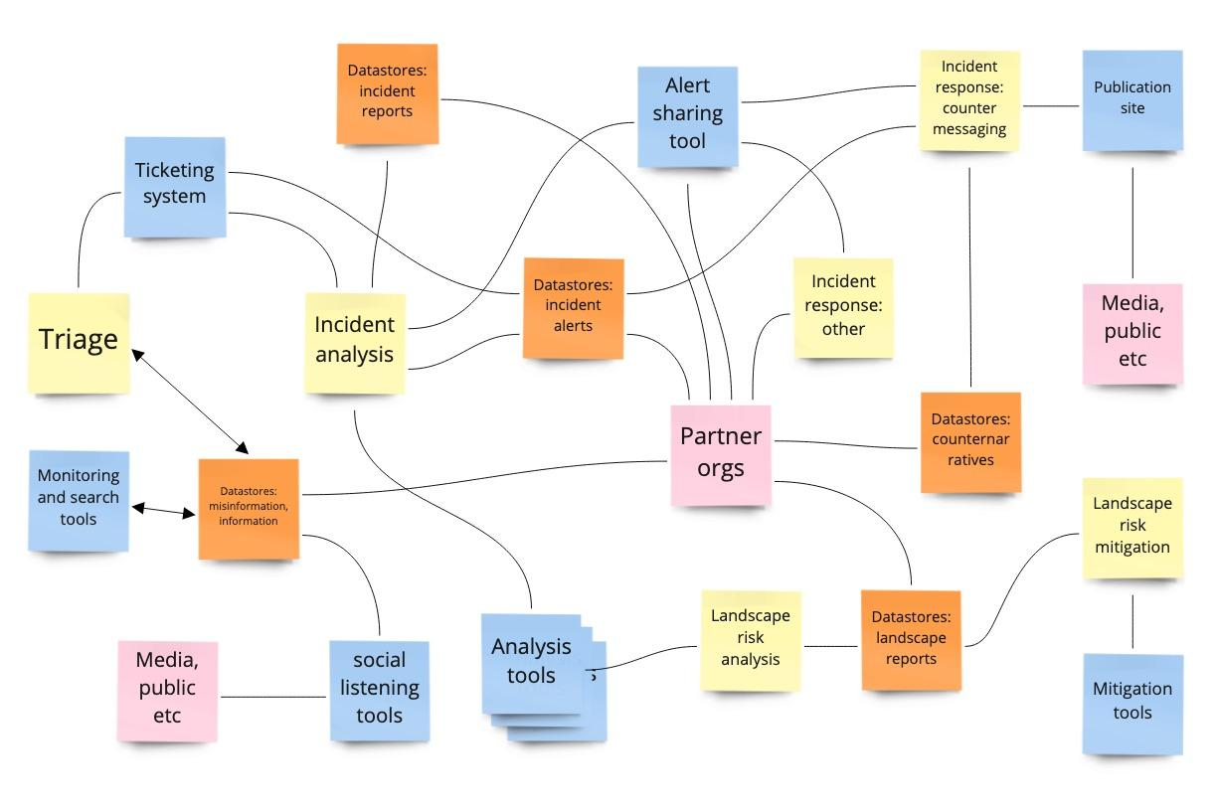
Set up toolset

Slide 12
Typical tool needs
Data gathering:
Internet: looking for trends, known narratives, new narratives, and risk activity in social media, websites, and other places that people seek and share information online. Media: looking for trends, known narratives, new narratives, and risk activity in traditional mass media, including newspapers, radio, and TV. Some of this monitoring can be covered by searching media’s internet sites.
Other channels: messaging apps and word of mouth misinformation sharing cannot usually be tracked using internet monitoring tools. However, surveys, chatbots and other social listening tools can help to surface infodemic narratives and artifacts in these “dark” channels.
Analysis:
Situation assessment: making sense of the often-large volumes of data produced by monitoring.
text analysis: help identify and track narratives
graph analysis: help map information flows, find influencers, and identify and track coordinated online activity.
Information sharing:
Share information between teams of human analysts;
Response:
Message-based: getting prebunking, debunking and other messages to community segments in the channels that they use or trust, in forms they’re familiar with (e.g. languages, message styles, literacy levels, cultural appropriateness).
Other: sharing artifacts with platforms and other responders.

Slide 13
My toolset
Data gathering
Crowdtangle
Tineye / Yandex
Hypothes.is
Maltego
Profil3r
CheckUserNames
Hootsuite
Data storage and sharing
CSVs
STIX / TAXII
Archive.org
Analysis
Jupyter notebooks
Python libraries
(Pandas)
Gephi
AMITT Navigator
inVid
BuiltWith
Information sharing
MISP
Ticketing system
Googledocs
Spreadsheets
Response
Googledocs & spreadsheets
Notes:
Ticketing system, e.g. Jira
A good place to start is First Draft’s list of tools: https://start.me/p/vjv80b/first-draft-basic-toolkit

Slide 14
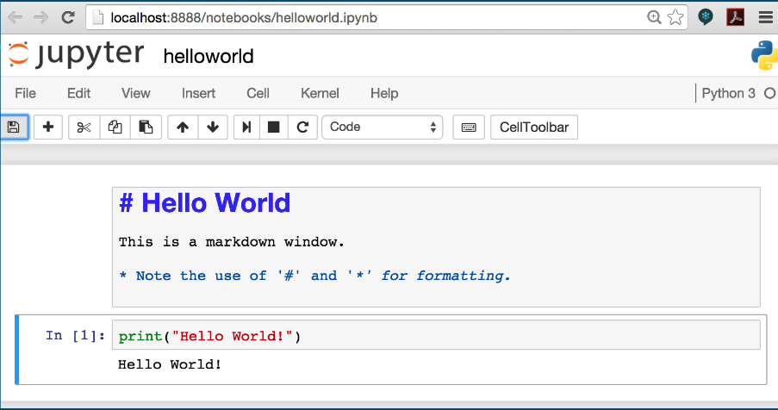
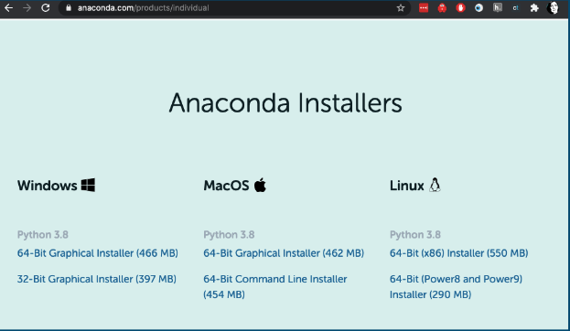
Jupyter notebook
https://www.anaconda.com/products/individual
Notes:
https://www.anaconda.com/products/individual - if you’re not sure what to choose, grab the graphical installer for the machine you’re on.
Click “continue” a lot. And yes, you do want the PyCharm IDE (I write python code using SublimeText, but PyCharm really is a lovely tool, and again if you’re not sure, just use it).

Slide 15
Organising analysis

Slide 16
Analysis types
Threat intelligence: “information an organization uses to understand the threats that have, will, or are currently targeting the organization. This info is used to prepare, prevent, and identify cyber threats looking to take advantage of valuable resources. “
Intelligence analysis: “process of taking known information about situations and entities of strategic, operational, or tactical importance, characterizing the known, and, with appropriate statements of probability, the future actions in those situations and by those entities”
OSINT: “intelligence produced from publicly available information that is collected, exploited, and disseminated in a timely manner to an appropriate audience for the purpose of addressing a specific intelligence requirement.”
Data science: “the field of study that combines domain expertise, programming skills, and knowledge of mathematics and statistics to extract meaningful insights from data”
Notes:
TI definition: https://www.forcepoint.com/cyber-edu/threat-intelligence
IA definition: https://www.recordedfuture.com/definition-of-intelligence-analysis/ - cool cool, looks like situation awareness definitions of old. E.g WTF is going on, what’s targetting us, what can we do about it?
OSINT definition: https://www.rand.org/content/dam/rand/pubs/research_reports/RR1900/RR1964/RAND_RR1964.pdf (which talks about how OSINT processing used to be simple: translation, then all-source analysis)
Data science is still debated, e.g. wikipedia says “Data science is an inter-disciplinary field that uses scientific methods, processes, algorithms ... in managing a digital data collection. There is still no consensus on the definition of data science and it is considered by some to be a buzzword.”

Slide 17
Tactical tasks
Credibility/ Verification
Fact-checking: verify article, image, video etc doesn’t contain disinformation.
Source-checking: verify source (publisher, domain etc) doesn’t distribute disinformation.
Network detection
Pinkslime finding: find inauthentic website networks
Network finding: find inauthentic account networks (including botnets)
Activity analysis
Detect computational amplification
Detect fake accounts
(e.g. Look at patterns of account creation dates for popular messages)
Detect, track and analyse narratives

Slide 18
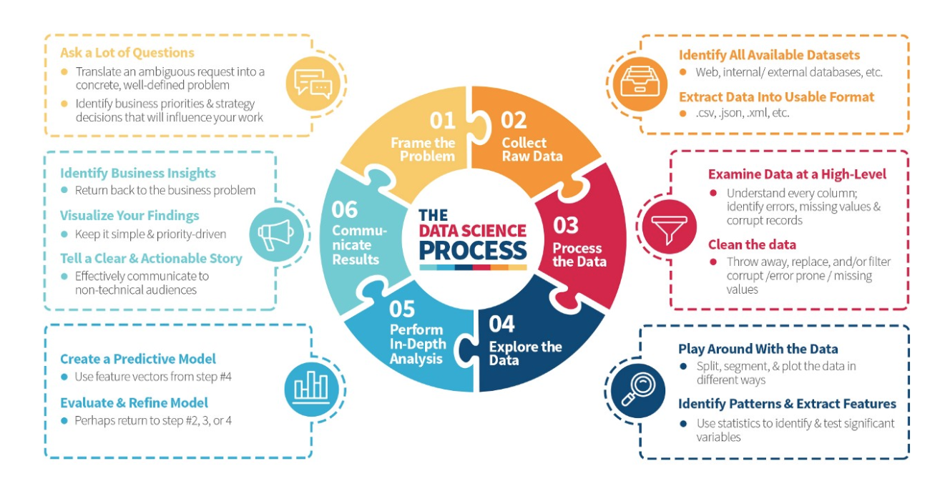
Data Science Process
https://medium.com/the-mission/deconstructing-data-science-breaking-the-complex-craft-into-its-simplest-parts-15b15420df21
Notes:
Read the blogpost btw - it’s a lovely description of what happens in data science.

Slide 19
Organising sharing / Reporting

Slide 20
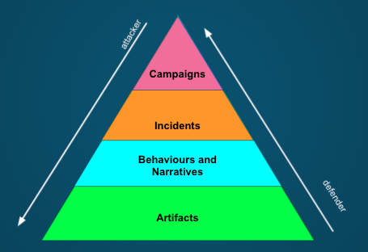
What’s in a report?

Slide 21
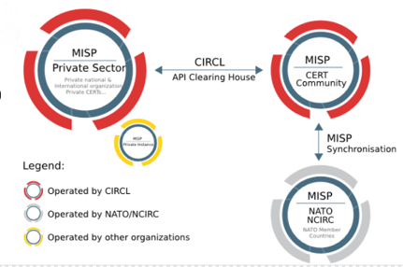
Information sharing: MISP
Threat sharing standard with large community
EU funded (ENISA, CIRCL)
ISAC, ISAO, CERTs, CSIRTs
NATO, Military, Intelligence
Fortune 500’s
Open data standards: MISP Core, STIX
Connections: API push/pull, Email, Anomali ThreatStream, ThreatConnect, OSQuery
New taxonomies
DFRLab Dichotomies of Disinformation
NATO Disinformation Taxonomy (WIP)
Notes:
This is one of the tools we've adapted: MISP is open-source and commonly used for infosec information sharing. It’s used by CERTs and intelligence agencies, and integrates with most CTI platforms. AMITT models now ship with every MISP open-source system.

Slide 22
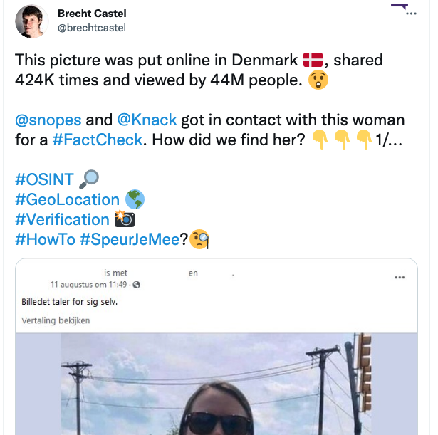
Information sharing: social media, newspapers
https://twitter.com/brechtcastel/status/1431612326759829513?s=19
https://twitter.com/conspirator0
https://www.vice.com/en/article/93yvmv/qanon-ghostezra-is-robert-randall-smart

Slide 23
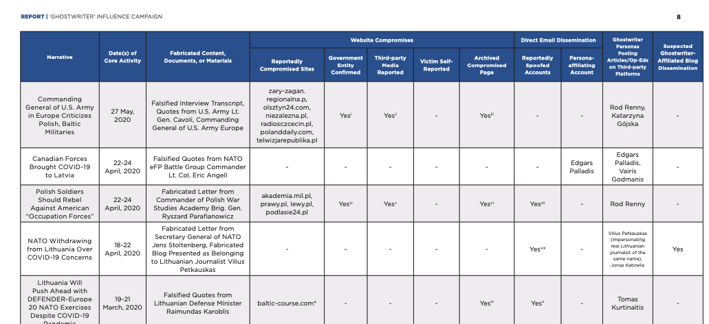
Information sharing: reports
EuVsDisinfo database https://euvsdisinfo.eu/disinformation-cases/
Atlantic Council DFRLab https://medium.com/dfrlab
Graphika https://graphika.com/reports
Facebook https://about.fb.com/news/2021/08/july-2021-coordinated-inauthentic-behavior-report/
FireEye https://www.fireeye.com/blog/threat-research/2020/07/ghostwriter-influence-campaign.html
Many many factchecking orgs https://datastudio.google.com/reporting/a8491164-6aa8-45d0-b609-c70339689127/page/ierzB

Slide 24
Strategic report examples
Fireeye looking at Iranian network: Network of Social Media Accounts Impersonates U.S. Political Candidates, Leverages U.S. and Israeli Media in Support of Iranian Interests
Graphika tracking GRU network: From Russia With Blogs
DFRlab on MyRan commercial operation: Facebook shut down commercial disinformation network based in Myanmar and Vietnam
Vice reporting, unknown researcher on targetted deepfakes: Deepfakes by BJP in Indian Delhi Election Campaign

Slide 25
Session 5.2: Content analysis
Disinformation/Malign Influence Training
SJ Terp & P Breuer, Threet Consulting | 2021

Slide 26
Content analysis
Set up
Setting up notebooks
Keeping track of what you’ve found
Content analysis
Techniques and tools for assessing misinformation artifacts: images, text, accounts, groups, domains etc.
Text analysis

Slide 27
Text analysis

Slide 28
Text Processing
Information retrieval
Search
Named entity recognition
Learning
Classification
Clustering
Topic identification/ topic following
Sentiment analysis
Network analysis (words, people etc)
Comprehension
Natural language processing
Translation
Truthiness
Gisting
Creation
Text generation

Slide 29
Data sources
Anywhere there’s text, e.g.
Social media: Twitter, Facebook, Reddit, Youtube, Instagram, Medium etc
Websites: https://commoncrawl.org/ extracts and saves text
Wikipedia / Wikidata
Documents
[Check the sources list in the BigBook]

Slide 30
Common Tools
Python libraries:
Scikit-Learn
NLTK
Gensim
Spacy
Standalone Tools:
GPT2 / GPT3
Weka
Notes:
Longer list: http://en.wikipedia.org/wiki/Social_network_analysis_software

Slide 31
Text as “bags of words”
Sentences:
“Oh really?”,
”Just like with radiation poisoning then.”
Words: “just”, “like”, “with”, etc
Trigrams: “jus”, “ust”, “st “, “t l”, “ li”, “lik” “ike”
Bigrams: “just like”, “like with”, “with radiation”, “radiation poisoning”
Stopwords: “with”, “on”, “then”, “what”, “have”, “they”, “been”, “out”, “in”, “the”, etc
"RT @KateShemirani: Oh really? Just like with radiation poisoning then. Put enough symptoms down on the diagnosis sheet and you can just abo… RT @Walletwalking1: @Sterling2143 @AAureilus Anyone noticed COVID symptoms are same as 5G exposure. What have they been rolling out in the… RT @ADDiane: Let's tell the people who won't wear masks that it's not for covid, it's for tricking the facial recognition software that dee… Discourse "

Slide 32
Word Importance: Named Entity Recognition
Finds names of people, organisations, locations etc in text
Can use to create social graphs
import spacy
nlp = spacy.load('en_core_web_sm')
sentence = "Bill Gates is selling 5G Covid19 data to Microsoft"
doc = nlp(sentence)
for ent in doc.ents:
print(ent.text, ent.label_)
Bill Gates PERSON
5 CARDINAL
Microsoft ORG
Notes:
See https://www.geeksforgeeks.org/python-named-entity-recognition-ner-using-spacy/

Slide 33
Sentiment: (some of) the feels
Word-based: give (some) words positive/negative scores
Use an existing ‘sentiment dictionary’
Score some words, use machine learning on the rest
Document-based: score documents and use machine learning
‘positive’/’negative’ for each sentence
Semantic/pragmatic: use natural language processing
Satire is hard to detect
“Nice work bro!”
Emoticons are a language too
Sentiment dictionaries:
Wordstat: https://provalisresearch.com/products/content-analysis-software/wordstat-dictionary/sentiment-dictionaries/
Sentiwordnet: https://github.com/aesuli/SentiWordNet
Emoticon sentiment lexicon: http://people.few.eur.nl/hogenboom/files/EmoticonSentimentLexicon.zip
Very positive
Positive
Neutral
Negative
Very negative
Notes:
Examples: https://monkeylearn.com/sentiment-analysis/
Why always 5 things on a scale? Because it’s a Likert scale
Again semantics might matter: aspect-based sentiment analysis = working out *what* people are happy, sad etc about.

Slide 34
Other analysis types

Slide 35
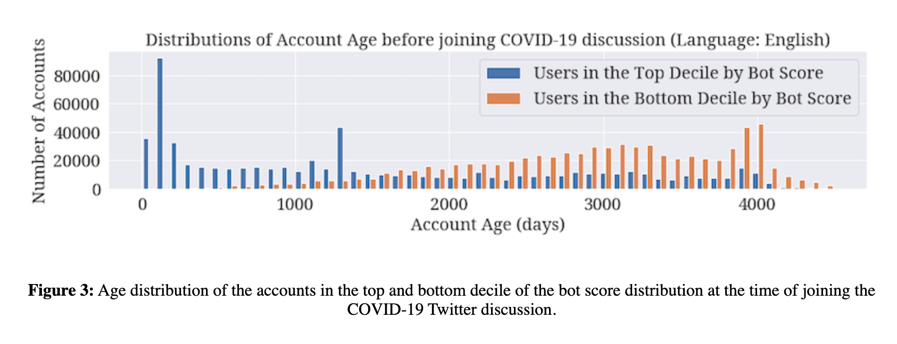
Emilio Ferrara on Covid19 disinfo
Notes:
https://firstmonday.org/ojs/index.php/fm/article/view/10633/9548

Slide 36
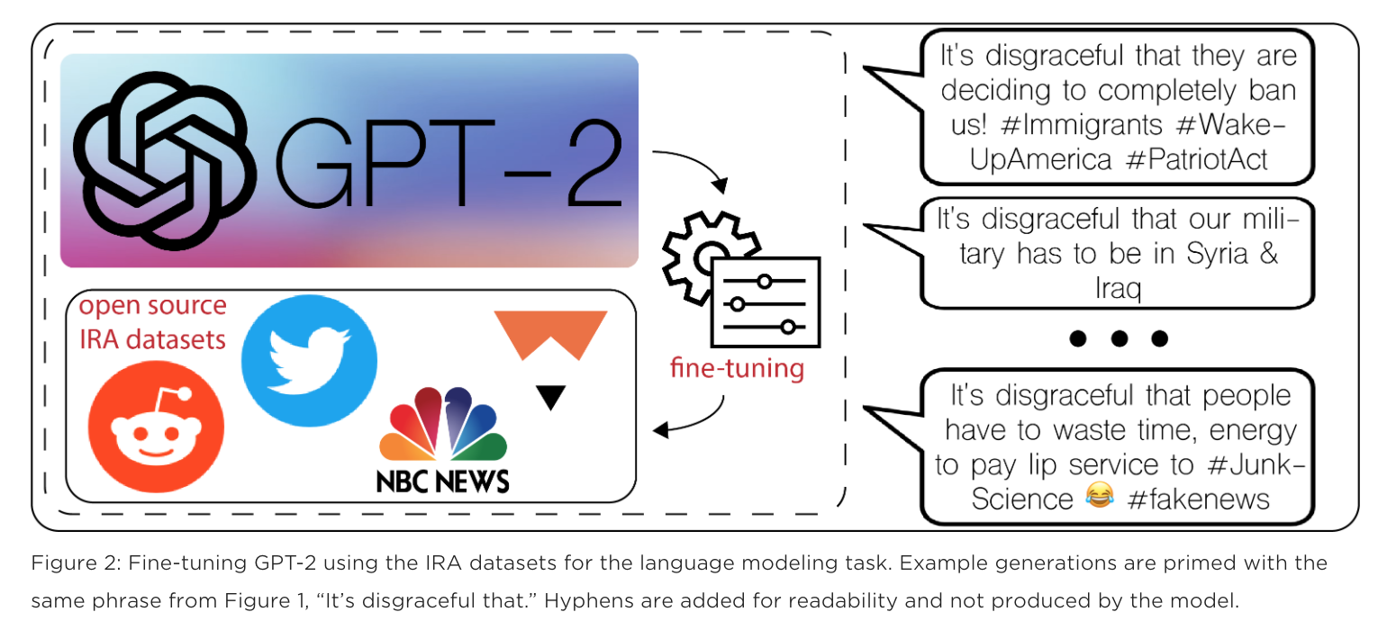
Generating to understand: Fireeye and GPT2
Notes:
Lee Foster, Phil Tully, Sajidur Rahman
https://www.fireeye.com/blog/threat-research/2019/11/combatting-social-media-information-operations-neural-language-models.html

